Slide 1
Assigning
Secondary Structure to Residues based on
Dihedral Angles
COMPUTATIONAL BIOPHYSICS (CS61060)

Slide 2
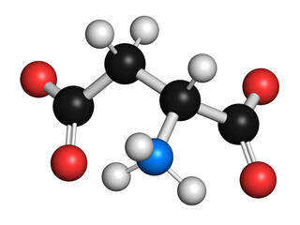
Our Team
JASWANTH KUMAR CHUKKA (20CS10021)
SATHVIK REDDY (20CS10028)
SAURABH JAISWAL (20CS30047

Slide 3
Table of contents
01
02
03
04
Problem Statement
PDB File
Problem regarding the input and Output parameters
Short description of PDB file used
Dihedral Angles
Results
Dihedral Angles phi and psi used for predicting secondary structure
You can describe the topic of the section here

Slide 4
Problem Statement
Input:
3D coordinates of a protein in PDB format
Output:
A list of secondary structure assignments for each residue in the protein, such as alpha
helix, beta sheet,beta turns, coil, etc.

Slide 5
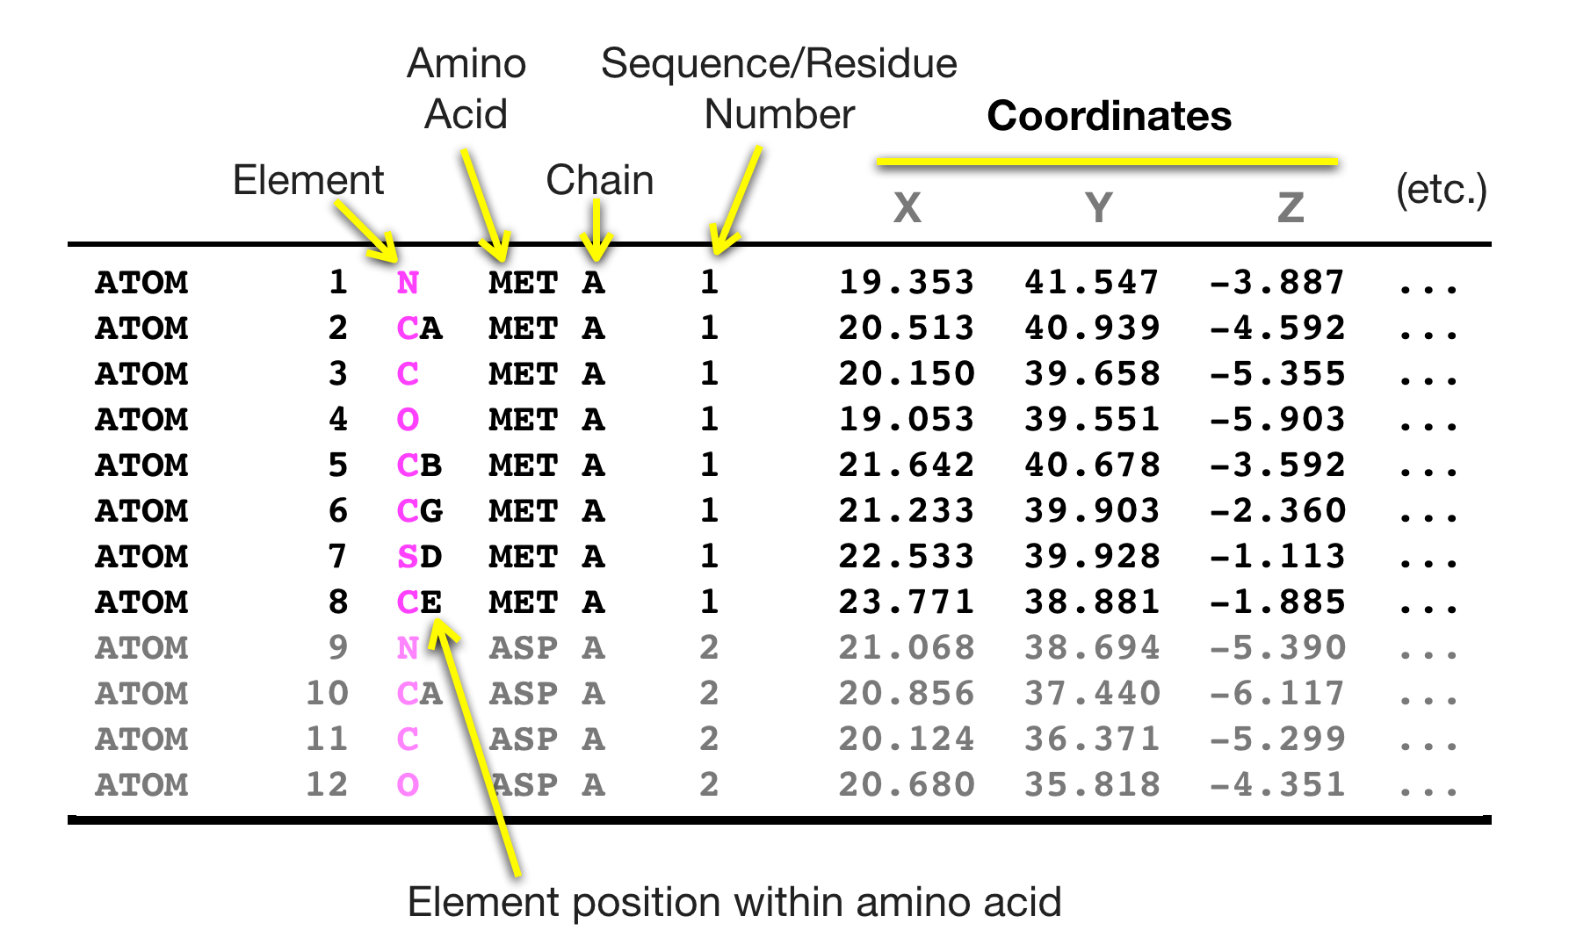
What is a PDB file?
A PDB (Protein Data Bank) file is a file format used to store 3D molecular structures of proteins, nucleic acids, and other biological macromolecules.
It contains information about the 3D coordinates of the atoms that make up the molecule, as well as information about the bonds, angles, and other properties of the molecule.

Slide 6
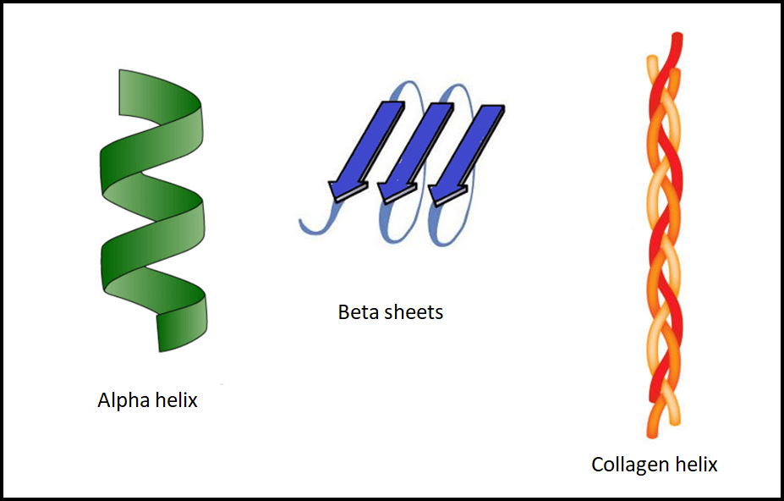
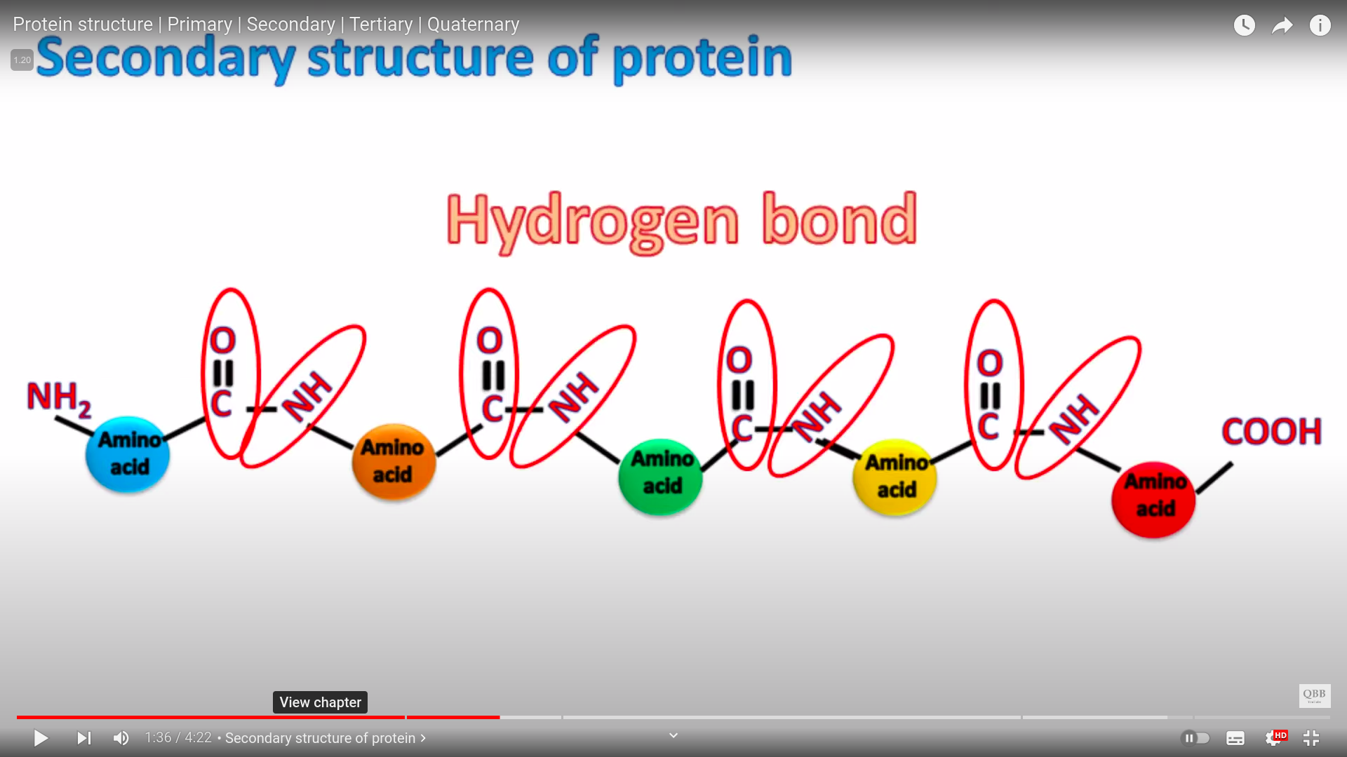
Secondary Structure of Protein
The secondary structure of a protein refers to the local spatial arrangement of its amino acid residues.
The secondary structure of a protein is determined by the hydrogen bonding patterns between the peptide backbone atoms. In the alpha helix, the hydrogen bonds are formed between the carbonyl oxygen of one amino acid and the amide hydrogen of an amino acid located four residues away. In the beta sheet, the hydrogen bonds are formed between neighboring strands in the sheet.
Alpha-helix
Beta Strands
Coil
By Mars

Slide 7
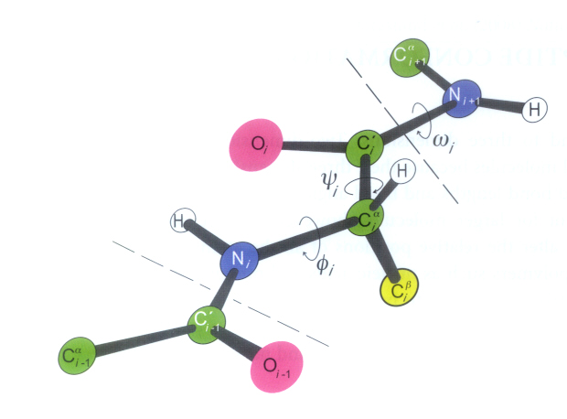
Calculation of Dihedral Angles (𝝓, 𝝍)
Dihedral angles in protein residues are typically calculated using the positions of four consecutive atoms in the amino acid backbone.
Specifically, the dihedral angle is defined by the positions of the nitrogen (N), alpha carbon (Cα), carbonyl carbon (C), and the next nitrogen (N+1) atoms in the backbone.
The dihedral angle is the angle between the plane formed by atoms N, Cα, and C, and the plane formed by atoms Cα, C, and N+1. This angle is often denoted as φ for the angle between N-Cα-C-N+1, and ψ for the angle between Cα-C-N+1-Cα.

Slide 8
Assigning secondary structure
- based on dihedral angles
To assign the secondary structure of a residue in a protein based on its dihedral angles phi(𝝓) and psi(𝝍), we used the Ramachandran plot and the STRIDE Algorithm. The Ramachandran plot is a scatter plot that shows the distribution of phi and psi angles for amino acid residues in protein structures, and it is commonly used to identify the secondary structure of a residue based on its location in the plot.
The Ramachandran plot is divided into different regions, each corresponding to a specific secondary structure type, such as alpha helix, beta strands, or coil.
If the residue falls in the region corresponding to an alpha helix, it is likely part of an alpha helix. Similarly, if it falls in the region corresponding to a beta strand, it is likely part of a beta strand. If it falls in the region corresponding to a coil, it is likely part of a loop or turn.

Slide 9
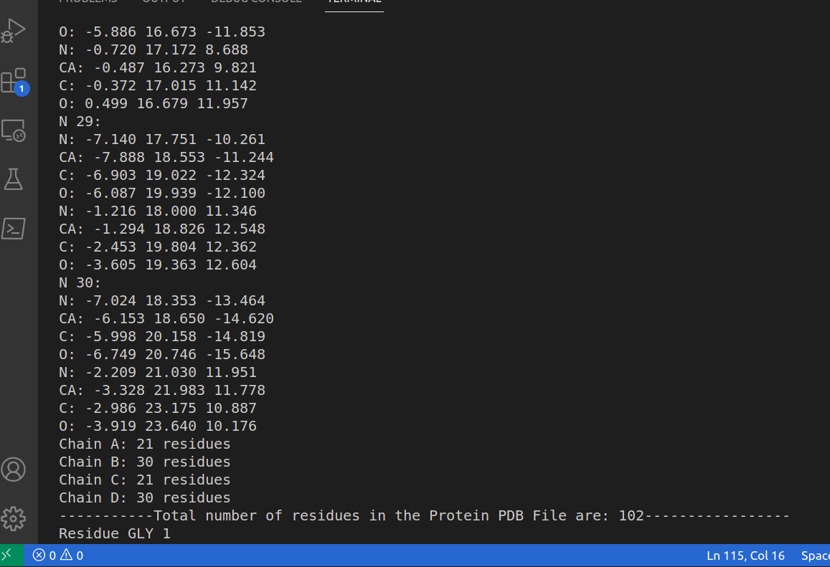
RESULTS
PDB file of Insulin: PDB ID 1trz

Slide 10
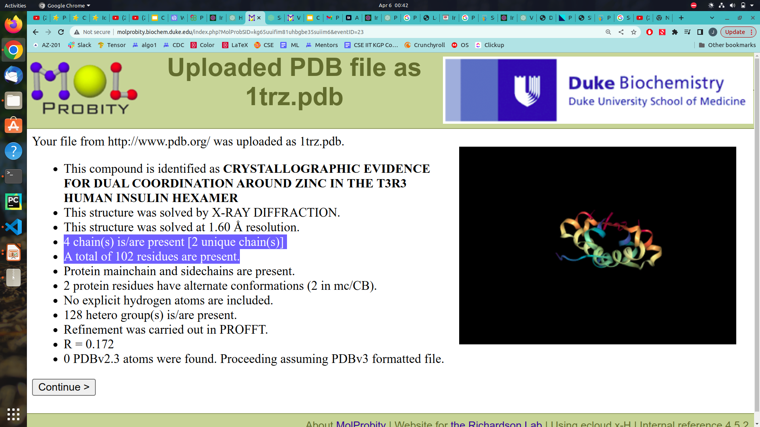
http://molprobity.biochem.duke.edu/index.php

Slide 11
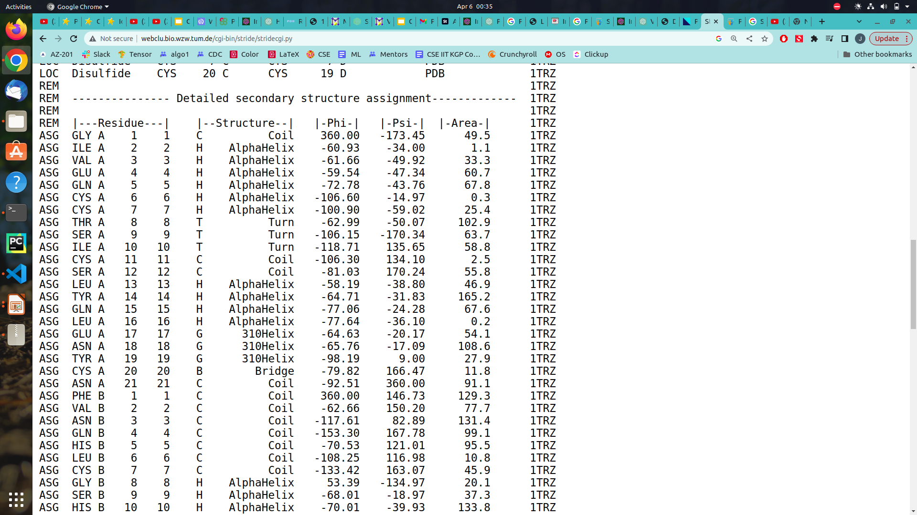
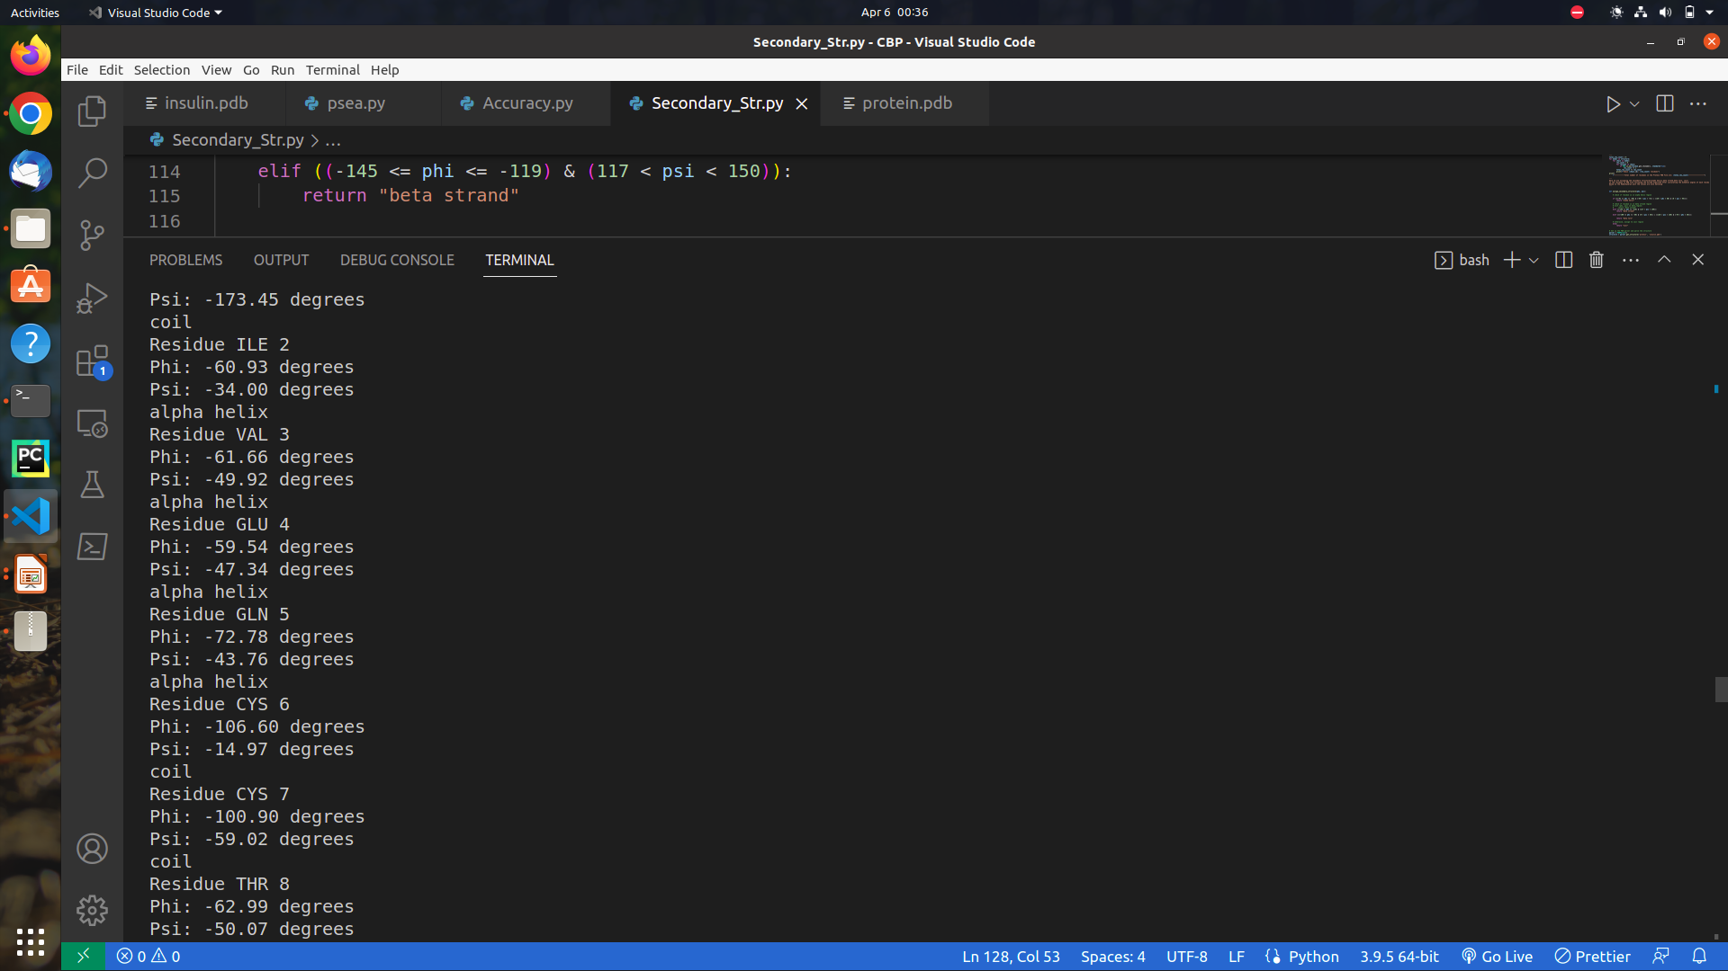

Slide 12
Resources
STRIDE ALGORITHM WEB Page:
http://webclu.bio.wzw.tum.de/stride/
Research Papers:
https://bmcbioinformatics.biomedcentral.com/articles/10.1186/1471-2105-10-437
https://www.ncbi.nlm.nih.gov/pmc/articles/PMC1891663/
http://molprobity.biochem.duke.edu/index.php
https://link.springer.com/chapter/10.1007/978-3-319-01845-4_13

Slide 13
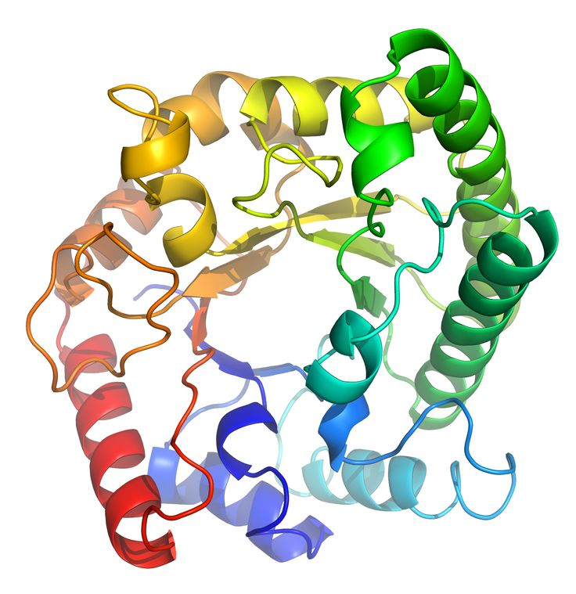
THANK YOU

